Slide 1






Uma Dashboard de Gelo e Fogo
Integrantes Casa Resilia
Honer
Isa
Anna
Amanda

Slide 2

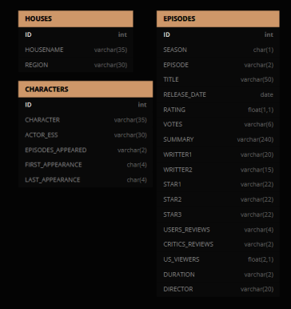

CREATE TABLE `HOUSES` (
`HOUSENAME` varchar(35),
`REGION` varchar(30)
);
CREATE TABLE `CHARACTERS` (
`CHARACTER` varchar(35),
`ACTOR_ESS` varchar(30),
`EPISODES_APPEARED` varchar(2),
`FIRST_APPEARANCE` char(4),
`LAST_APPEARANCE` char(4)
);
CREATE TABLE `EPISODES` (
`SEASON` char(1),
`EPISODE` varchar(2),
`TITLE` varchar(50),
`RELEASE_DATE` date,
`RATING` float(1,1),
`VOTES` varchar(6),
`SUMMARY` varchar(240),
`WRITTER1` varchar(20),
`WRITTER2` varchar(15),
`STAR1` varchar(22),
`STAR2` varchar(22),
`STAR3` varchar(22),
`USERS_REVIEWS` varchar(4),
`CRITICS_REVIEWS` varchar(2),
`US_VIEWERS` float(2,1),
`DURATION` varchar(2),
`DIRECTOR` varchar(20)
);
CRIAÇÃO DAS TABELAS

Slide 3
CREATE TABLE EPISODES (
SEASON char(1),
EPISODE varchar(2),
TITLE varchar(50),
RATING float,
VOTES varchar(6),
SUMMARY varchar(240),
WRITTER1 varchar(20),
WRITTER2 varchar(15),
STAR1 varchar(22),
STAR2 varchar(22),
STAR3 varchar(22),
USERS_REVIEWS varchar(4),
CRITICS_REVIEWS varchar(2),
US_VIEWERS float,
DURATION varchar(2),
DIRECTOR varchar(20)
);
-- Povoar Tabelas com CSVs de Game of
Thrones em https://drive.google.com/drive/folders/1F9Rwbzzz4LJCxZU-mTR4JqDT_2vJ7-sC?usp=sharing
-- Criação do Banco de dados
DROP DATABASE IF EXISTS GAME_OF_THRONES;
CREATE DATABASE GAME_OF_THRONES;
USE GAME_OF_THRONES;
-- Tabelas Iportadas do SQL gerado no Site
CREATE TABLE HOUSES (
HOUSENAME varchar(35),
REGION varchar(30)
);
CREATE TABLE CHARACTERS (
`CHARACTER` varchar(35),
ACTOR_ESS varchar(30),
EPISODES_APPEARED varchar(2),
FIRST_APPEARANCE char(4),
LAST_APPEARANCE char(4)
);

Slide 4
CREATE TABLE EPISODES (
SEASON char(1),
EPISODE varchar(2),
TITLE varchar(50),
RATING float,
VOTES varchar(6),
SUMMARY varchar(240),
WRITTER1 varchar(20),
WRITTER2 varchar(15),
STAR1 varchar(22),
STAR2 varchar(22),
STAR3 varchar(22),
USERS_REVIEWS varchar(4),
CRITICS_REVIEWS varchar(2),
US_VIEWERS float,
DURATION varchar(2),
DIRECTOR varchar(20)
);
-- Povoar Tabelas com CSVs de Game of
Thrones em https://drive.google.com/drive/folders/1F9Rwbzzz4LJCxZU-mTR4JqDT_2vJ7-sC?usp=sharing
-- Criação do Banco de dados
DROP DATABASE IF EXISTS GAME_OF_THRONES;
CREATE DATABASE GAME_OF_THRONES;
USE GAME_OF_THRONES;
-- Criação das Tabelas
CREATE TABLE HOUSES (
HOUSENAME varchar(35),
REGION varchar(30)
);
CREATE TABLE CHARACTERS (
`CHARACTER` varchar(35),
ACTOR_ESS varchar(30),
EPISODES_APPEARED varchar(2),
FIRST_APPEARANCE char(4),
LAST_APPEARANCE char(4)
);

Slide 5
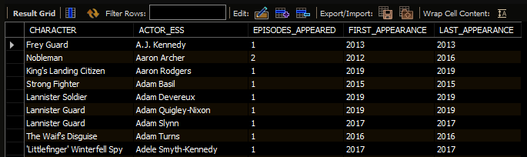
-- Teste das tabelas povoadas corretamente
SELECT * FROM CHARACTERS;
SELECT * FROM EPISODES;
SELECT * FROM HOUSES;
-- Criando PK em `CHARACTERS` E FK EM `EPISODES`
ALTER TABLE CHARACTERS ADD PRIMARY KEY (ACTOR_ESS);
ALTER TABLE `EPISODES` ADD CONSTRAINT fk_ACTOR_ESS_ID
FOREIGN KEY (`STAR1`) REFERENCES `CHARACTERS`(`ACTOR_ESS`);

Slide 6
-- Filtro para gráfico "TOP 10 QUANTIDADE DE CASAS POR REGIÃO"
SELECT `REGION`,COUNT(*) AS TOTAL
FROM `HOUSES` GROUP BY `REGION`
ORDER BY TOTAL DESC LIMIT 10
INTO OUTFILE 'C:/ProgramData/MySQL/MySQL Server 8.0/Uploads/REGIONS.csv'
FIELDS TERMINATED BY ","
ENCLOSED BY '"'
LINES TERMINATED BY '\n';

Slide 7
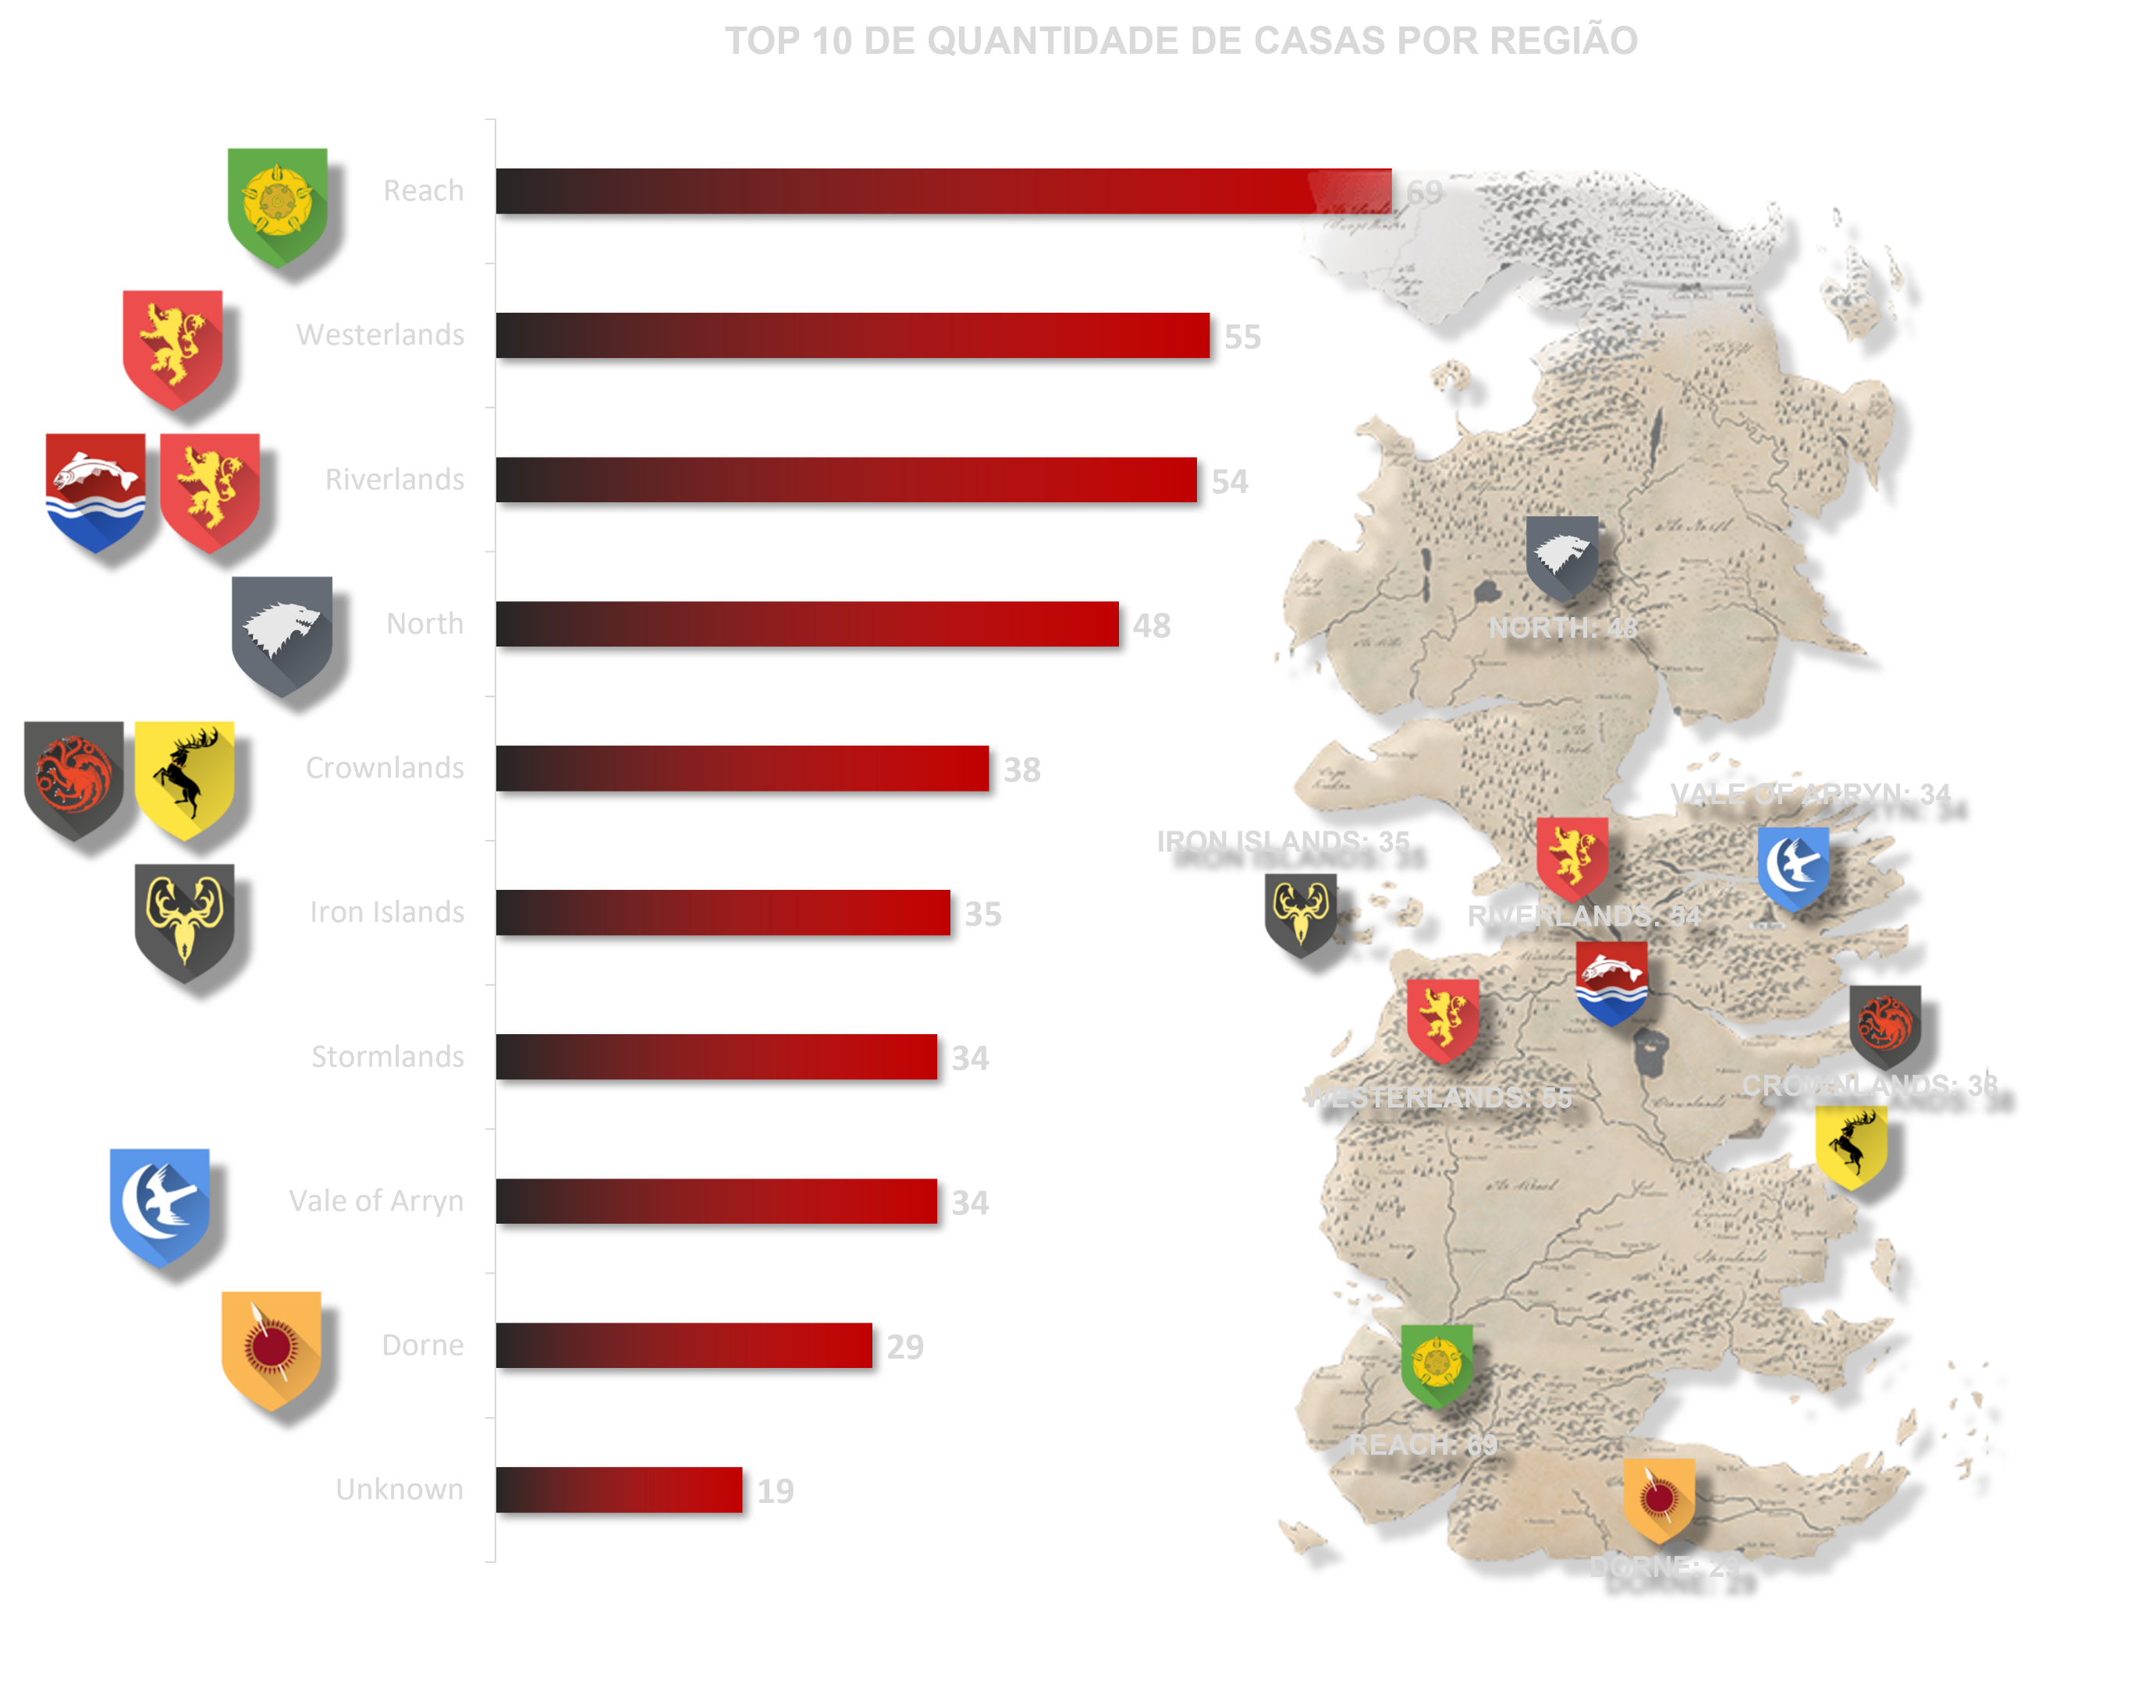
RESULTADO
REGIÃO | CASAS
Reach | 69
Westerlands | 55
Riverlands | 54
North | 48
Crownlands | 38
Iron Islands | 35
Vale of Arryn | 34
Stormlands | 34
Dorne | 29
Unknown | 19

Slide 8
RESULTADO
REGIÃO | CASAS
Reach | 69
Westerlands | 55
Riverlands | 54
North | 48
Crownlands | 38
Iron Islands | 35
Vale of Arryn | 34
Stormlands | 34
Dorne | 29
Unknown | 19

Slide 9
-- Filtro para gráfico " PERSONAGENS VIVOS POR MAIS TEMPO E EM QUANTOS EPISÓDIOS APARECERAM"
SELECT `CHARACTER`, `LAST_APPEARANCE`-`FIRST_APPEARANCE`
AS TOTAL FROM `CHARACTERS`ORDER BY TOTAL DESC;
-- Sabendo que o máximo de anos é 8 temos o filtro abaixo
SELECT `CHARACTER`, `EPISODES_APPEARED`, `LAST_APPEARANCE`-`FIRST_APPEARANCE`
AS TOTAL FROM `CHARACTERS`
WHERE (`LAST_APPEARANCE`-`FIRST_APPEARANCE`) = 8 ORDER BY `EPISODES_APPEARED` DESC
INTO OUTFILE 'C:/ProgramData/MySQL/MySQL Server 8.0/Uploads/TOP_APEA.csv'
FIELDS TERMINATED BY ","
ENCLOSED BY '"'
LINES TERMINATED BY ’\N';

Slide 10
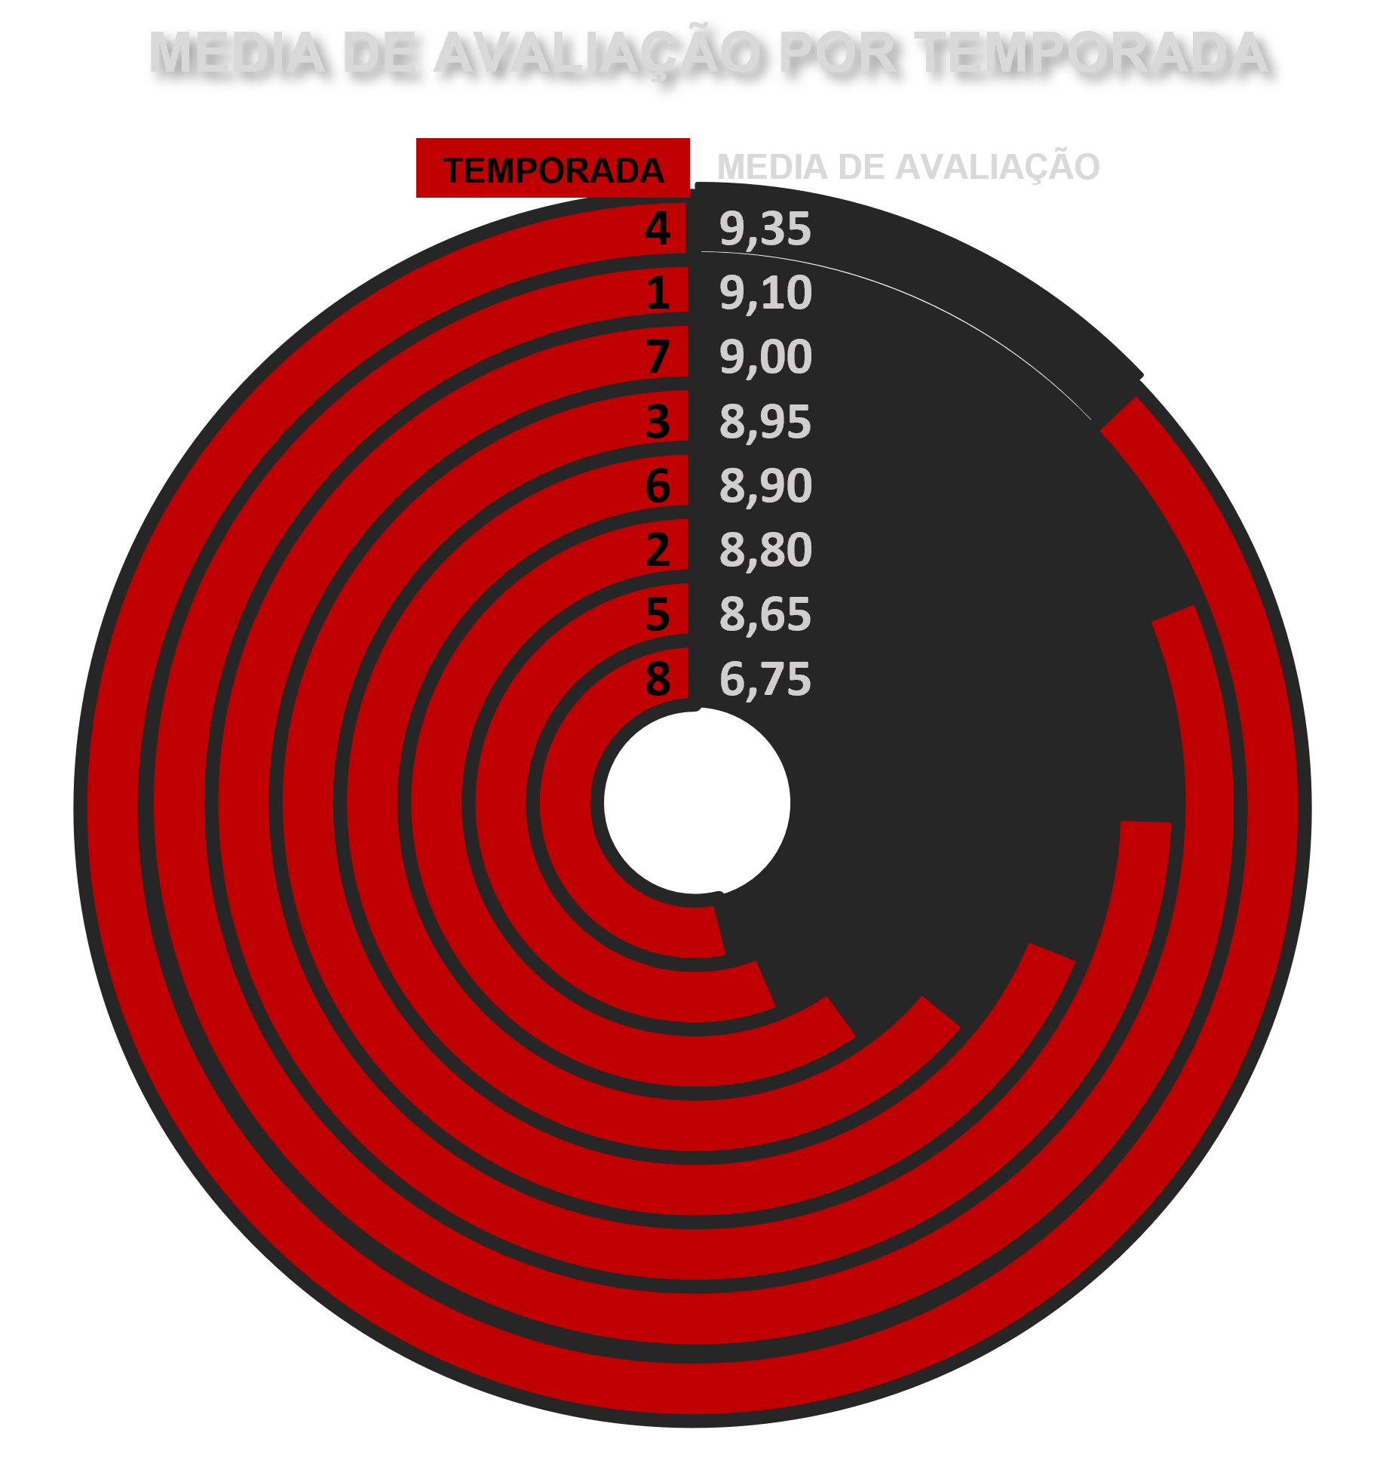
RESULTADO
TEMPORADA | RATING
1 | 8,7
2 | 8,7
3 | 8,75
4 | 8,8
5 | 8,8
6 | 8,9
7 | 9
8 | 9
10 | 9,45
9 | 9,65
TEMPORADA | RATING
9 | 8,7
8 | 8,7
7 | 8,75
6 | 8,8
5 | 8,8
4 | 8,9
3 | 9
2 | 9
1 | 9,45
0,5 | 9,65

Slide 11
RESULTADO
TEMPORADA | RATING
1 | 8,7
2 | 8,7
3 | 8,75
4 | 8,8
5 | 8,8
6 | 8,9
7 | 9
8 | 9
10 | 9,45
9 | 9,65
TEMPORADA | RATING
9 | 8,7
8 | 8,7
7 | 8,75
6 | 8,8
5 | 8,8
4 | 8,9
3 | 9
2 | 9
1 | 9,45
0,5 | 9,65

Slide 12
-- Filtro para Gráfico "TEMPORADAS MELHOR AVALIADAS"
SELECT `SEASON`, ROUND (AVG (`RATING`),2)
FROM `EPISODES`
GROUP BY `SEASON`
ORDER BY AVG (`RATING`) DESC
INTO OUTFILE 'C:/ProgramData/MySQL/MySQL Server 8.0/Uploads/TEMPORADA_MEDIA.csv'
FIELDS TERMINATED BY ","
ENCLOSED BY '"'
LINES TERMINATED BY ’\N';

Slide 13
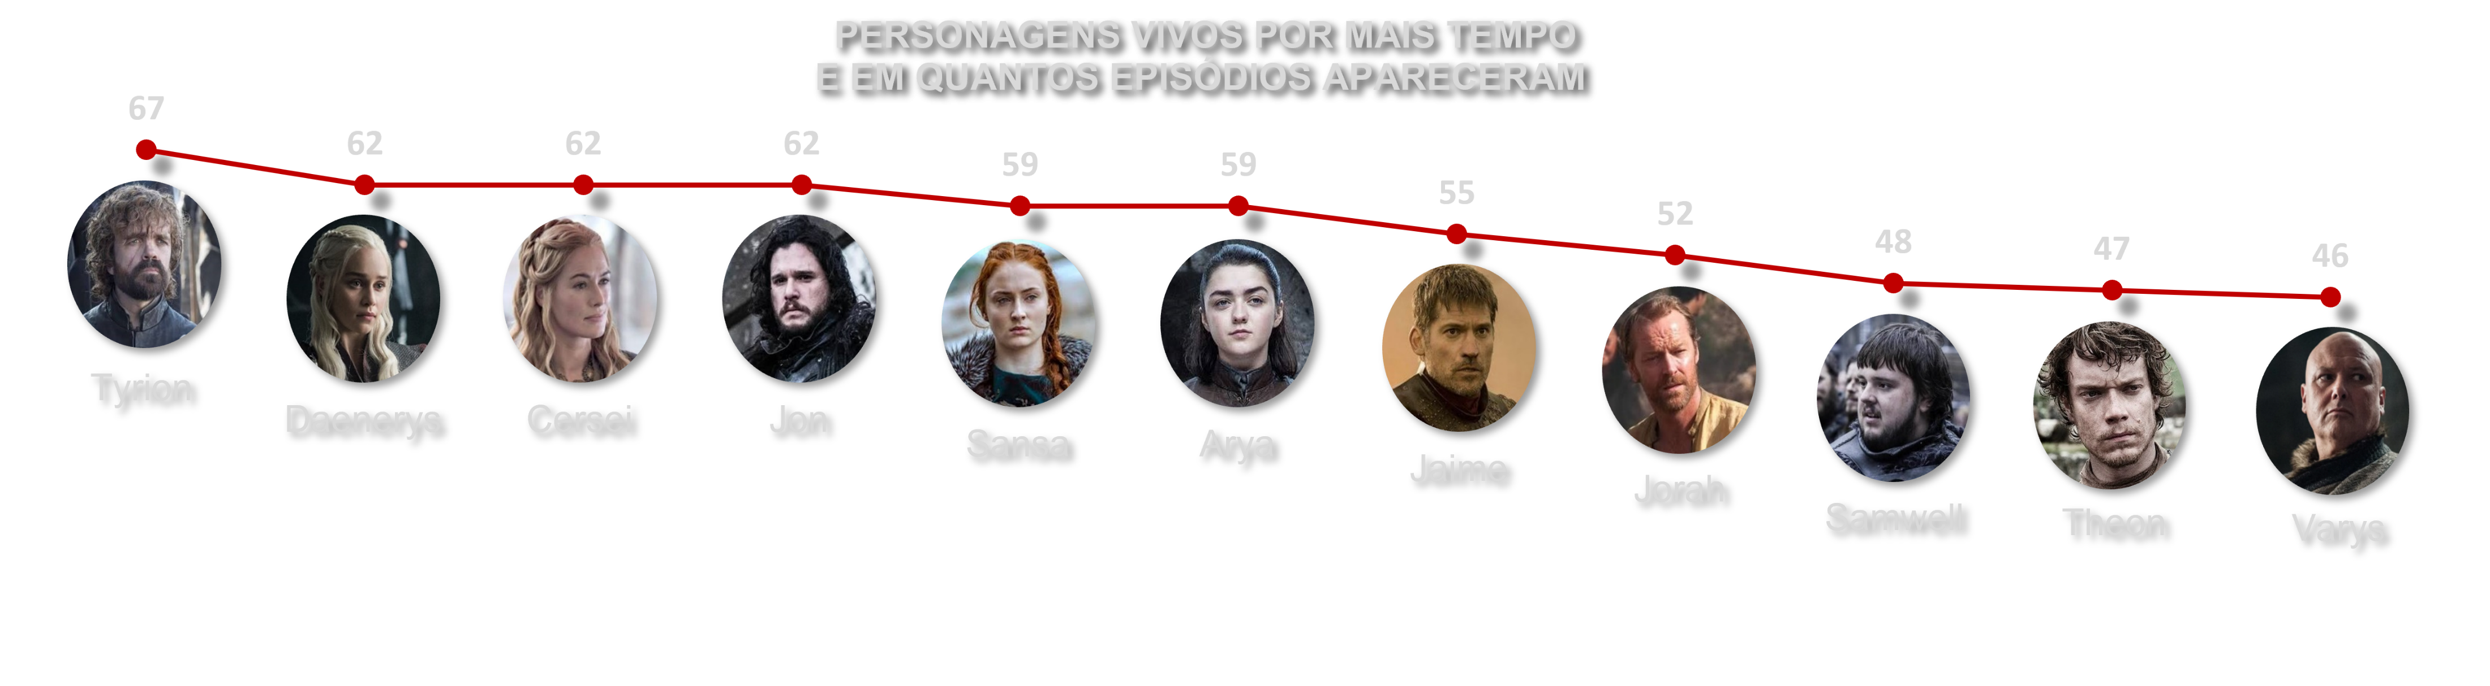
PERSONAGEM | ATOR/ATRIZ | TOTAL EPISÓDIOS | ANO ENTRADA | ANO SAÍDA | TOTAL ANOS
Bronn | Jerome Flynn | 37 | 2011 | 2019 | 8
Jaime Lannister | Nikolaj Coster-Waldau | 55 | 2011 | 2019 | 8
Lord Varys | Conleth Hill | 46 | 2011 | 2019 | 8
Sansa Stark | Sophie Turner | 59 | 2011 | 2019 | 8
Sandor 'The Hound' Clegane | Rory McCann | 38 | 2011 | 2019 | 8
Jorah Mormont | Iain Glen | 52 | 2011 | 2019 | 8
Robin Arryn | Lino Facioli | 9 | 2011 | 2019 | 8
Arya Stark | Maisie Williams | 59 | 2011 | 2019 | 8
Samwell Tarly | John Bradley | 48 | 2011 | 2019 | 8
Gendry | Joe Dempsie | 24 | 2011 | 2019 | 8
Daenerys Targaryen | Emilia Clarke | 62 | 2011 | 2019 | 8
Cersei Lannister | Lena Headey | 62 | 2011 | 2019 | 8
Jon Snow | Kit Harington | 62 | 2011 | 2019 | 8
Theon Greyjoy | Alfie Allen | 47 | 2011 | 2019 | 8
Bran Stark | Isaac Hempstead Wright | 40 | 2011 | 2019 | 8
Wun Wun | Ian Whyte | 16 | 2011 | 2019 | 8
Tyrion Lannister | Peter Dinklage | 67 | 2011 | 2019 | 8

Slide 14
PERSONAGEM | ATOR/ATRIZ | TOTAL EPISÓDIOS | ANO ENTRADA | ANO SAÍDA | TOTAL ANOS
Bronn | Jerome Flynn | 37 | 2011 | 2019 | 8
Jaime Lannister | Nikolaj Coster-Waldau | 55 | 2011 | 2019 | 8
Lord Varys | Conleth Hill | 46 | 2011 | 2019 | 8
Sansa Stark | Sophie Turner | 59 | 2011 | 2019 | 8
Sandor 'The Hound' Clegane | Rory McCann | 38 | 2011 | 2019 | 8
Jorah Mormont | Iain Glen | 52 | 2011 | 2019 | 8
Robin Arryn | Lino Facioli | 9 | 2011 | 2019 | 8
Arya Stark | Maisie Williams | 59 | 2011 | 2019 | 8
Samwell Tarly | John Bradley | 48 | 2011 | 2019 | 8
Gendry | Joe Dempsie | 24 | 2011 | 2019 | 8
Daenerys Targaryen | Emilia Clarke | 62 | 2011 | 2019 | 8
Cersei Lannister | Lena Headey | 62 | 2011 | 2019 | 8
Jon Snow | Kit Harington | 62 | 2011 | 2019 | 8
Theon Greyjoy | Alfie Allen | 47 | 2011 | 2019 | 8
Bran Stark | Isaac Hempstead Wright | 40 | 2011 | 2019 | 8
Wun Wun | Ian Whyte | 16 | 2011 | 2019 | 8
Tyrion Lannister | Peter Dinklage | 67 | 2011 | 2019 | 8

